Slide 1

Multi-Level Deep Learning Model for Potato Leaf Disease Recognition_{[1]}
CSE 707: Individual Paper Presentation
Presented By
Presented To
ST - Ehsanur Rahman Rhythm RA - Md Humaion Kabir Mehedi
Team - 09
Marufa Kamal- 22366033
Annajiat Alim Rasel
Senior Lecturer,
Dept of Computer Science and Engineering, BRAC University

Slide 2
Index
1
Introduction
2
Methodology
3
Results and Discussion
4
Conclusion and Future Works
5
References

Slide 3
Introduction
Plant diseases affect leaves, stems, roots and fruits, reducing crop quality and quantity, leading to food deprivation and increase in production cost.
The estimated annual crop yield loss due to crop disease is about 16% globally.
Traditional plant disease diagnostic techniques rely on visual estimation and farmer experience, while newer techniques such as spectrometry, PCR and RT-PCR are more efficient but challenging, expensive, time-consuming and require highly professional operation
Advancements in AI, ML and Deep Learning techniques such as k-means clustering, Faster RCNN, CNN can help detect these diseases more efficiently.

Slide 4
Key Contributions
Preparing a Region Based Dataset
Due to the variation in potato diseases in different parts of the world caused by variations in various factors such as shape, varieties etc, a dataset containing potato leaf disease images from Central Punjab region of Pakistan is prepared.
Using YOLOv5 a Potato Leaf Segmentation and Extraction Technique is developed.
Convolutional Neural Network(CNN) model has been used to detect early blight, late blight and healthy potato leaves
Image Segmentation & Extraction
Potato Leaf Disease Detection

Slide 5
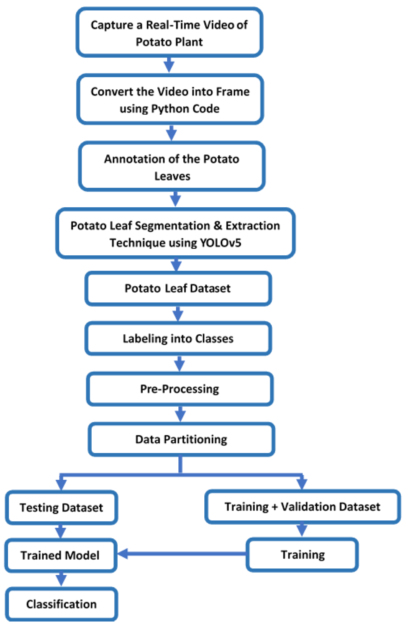
Methodology
Capture the real-time videos and images of Potato plants from the lab and field environment.
Convert the videos to frames (images).
Annotate the potato leaf images (single class) and save the annotation in YOLOv5 and XML format.
Pre-processing (auto-orient and resize) is applied to the annotated images.
Pre-processing (data augmentation) is applied to the training set.
Save the Potato Leaf Images Dataset into YOLOv5 PyTorch format.
Train and validate the custom YOLOv5s model with the help of Google Colab by using the Potato Leaf Images Dataset.
Classification output of YoloV5s model and using the annotations of Potato Leaf Images Dataset, potato leaves were extracted/segmented and made Potato Leaf Disease Dataset (PLD).
Figure 1. A flowchart of the proposed model.

Slide 6
Methodology
Label the images of PLD with the help of plant pathologists with their respective classes.
Pre-process all the images by applying data augmentation.
Divide the dataset among training, validation and testing with 80%, 10% and 10% ratios, respectively.
Train the CNN model with the help of training images.
Use the validation images to validate the CNN model at the end of each epoch.
Save the Trained PDDCNN Model.
Testing is applied to the PDDCNN trained model using testing images.
Figure 1. A flowchart of the proposed model.

Slide 7
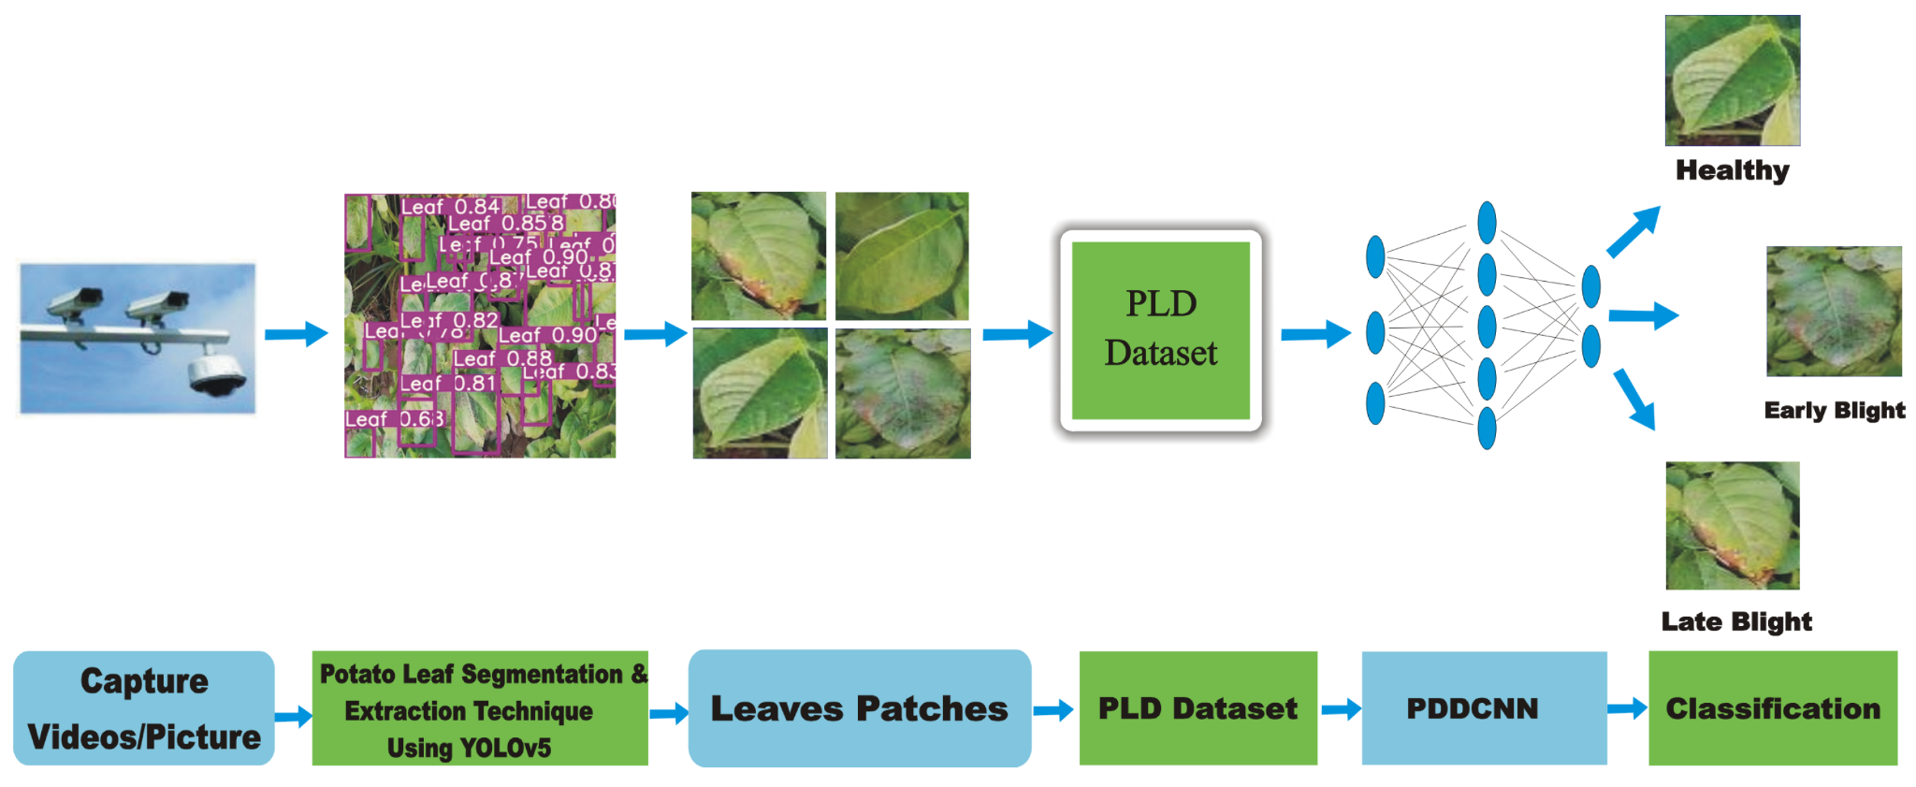
Methodology
Figure 2. The overall architecture of the proposed model.

Slide 8
Methodology
Convolution Layers | 3 (with 3 × 3 filters/kernels each)
Max-Pooling Layers | 3 (with (2, 2) pool size each)
Hidden Layer Neurons | 512 (1st), 256 (2nd), 128 (3rd)
Output Layer Activation Function | Softmax
Batch size | 32
Epochs | 100
Training Optimiser | Adam
Loss Function | Categorical Cross Entropy
Table 01. The proposed PDDCNN model configuration details of various parameters.

Slide 9
Summary of Dataset Used
Class Labels | Samples
Early Blight | 1628
Late Blight | 1414
Healthy | 1020
Total Samples | 4062
Class Labels | Samples
Early Blight | 1000
Late Blight | 1000
Healthy | 152
Total Samples | 2152
Table 02: PLD Dataset(Prepared)
Table 03: Plant Village Dataset

Slide 10
Result and Discussion
 | Performance Measures | Early Blight | Healthy | Late Blight | Average
With Data Augmentation | Accuracy | 99.38% | 100% | 100% | 99.75%
 | Precision | 100% | 99% | 100% | -
 | Recall | 99% | 100% | 100% | -
 | F1-Score | 100% | 100% | 99% | -
Without Data Augmentation | Accuracy | 93.87% | 84.47% | 92.25% | 91.15%
 | Precision | 87% | 94% | 90% | -
 | Recall | 92% | 85% | 88% | -
 | F1-Score | 96% | 92% | 94% | -
Table 04: Result of proposed PDDCNN on the PLD dataset

Slide 11
Result and Discussion
 | Performance Measures | Early Blight | Healthy | Late Blight | Average
With Data Augmentation | Accuracy | 99% | 92.31% | 95% | 96.71%
 | Precision | 95% | 100% | 98% | -
 | Recall | 99% | 92% | 95% | -
 | F1-Score | 97% | 96% | 96% | -
Without Data Augmentation | Accuracy | 91% | 100% | 96% | 93.90%
 | Precision | 97% | 93% | 91% | -
 | Recall | 91% | 100% | 96% | -
 | F1-Score | 94% | 96% | 94% | -
Table 05: Result of proposed PDDCNN on the Plant Village dataset

Slide 12
Result on Cross Validation
Training | Testing | Early Blight | Healthy | Late Blight | Total Testing | Overall
Dataset | Dataset | Accuracy | Accuracy | Accuracy | Images | Accuracy
PlantVillage | PLD | 95.71% | 08.82% | 23.94% | 807 | 48.89%
PLD | PlantVillage | 92.00% | 100% | 79.00% | 213 | 86.38%
Table 06: Classification accuracies of the proposed PDDCNN model training on PlantVillage and testing on PLD and training on PLD and testing on the PlantVillage dataset.

Slide 13
Result and Discussion
Existing Study | Total Parameters | Accuracy
Rozaqi and Sunyoto [2] | 6,812,995 | 92.00%
Islam et al. [3] | - | 95.00%
Barman et al. [4] | 16,407,395 | 96.98%
Tiwari et al.[5] | 143,667,240 | 97.80%
Lee et al. [6] | 10,089,219 | 99.00%
PDDCNN | 8,578,611 | 99.75%
Table 07: Comparison with existing studies.

Slide 14
Conclusion and Future Work
A multi-level deep learning model for potato leaf disease recognition was proposed, utilizing YOLOv5 image segmentation and PDDCNN for disease classification
The proposed PDDCNN method performed well on potato leaf images from Central Punjab, Pakistan
Future research includes multiple diseases detection on a single leaf, disease localization and severity estimation, enhancing the PLD dataset, developing IoT-based real-time monitoring systems, and launching a website and mobile application.

Slide 15
Reference List
[1] Rashid, J., Khan, I., Ali, G., Almotiri, S. H., AlGhamdi, M. A., & Masood, K. (2021). Multi-level deep learning model for potato leaf disease recognition. Electronics, 10(17), 2064.
[2] Rozaqi, A.J.; Sunyoto, A. Identification of Disease in Potato Leaves Using Convolutional Neural Network (CNN) Algorithm. In Proceedings of the 2020 3rd International Conference on Information and Communications Technology (ICOIACT), Yogyakarta, Indonesia, 24–25 November 2020; pp. 72–76
[3] Islam, M.; Dinh, A.; Wahid, K.; Bhowmik, P. Detection of potato diseases using image segmentation and multiclass support vector machine. In Proceedings of the 2017 IEEE 30th canadian conference on electrical and computer engineering (CCECE), Windsor, ON, Canada, 30 April–3 May 2017; pp. 1–4
[4] Barman, U.; Sahu, D.; Barman, G.G.; Das, J. Comparative Assessment of Deep Learning to Detect the Leaf Diseases of Potato based on Data Augmentation. In Proceedings of the 2020 International Conference on Computational Performance Evaluation (ComPE), Shillong, India, 2–4 July 2020; pp. 682–687.
[5] Tiwari, D.; Ashish, M.; Gangwar, N.; Sharma, A.; Patel, S.; Bhardwaj, S. Potato leaf diseases detection using deep learning. In Proceedings of the 2020 4th International Conference on Intelligent Computing and Control Systems (ICICCS), Madurai, India, 13–15 May 2020; pp. 461–466.
[6] Lee, T.Y.; Yu, J.Y.; Chang, Y.C.; Yang, J.M. Health Detection for Potato Leaf with Convolutional Neural Network. In Proceedings of the 2020 Indo–Taiwan 2nd International Conference on Computing, Analytics and Networks (Indo-Taiwan ICAN), Rajpura, India, 7–15 February 2020; pp. 289–293.

